Slide 1

Parking lot system
F2018 – mad3115 – Prof. Pritesh patel
Group #01 – Antonio | Giselle | Gurjeet

Slide 2
summary
Lessons learnt
Difficulties
Scrum
Content
Quick demonstration
references

Slide 3
Lessons learnt
[Giselle] How to use Firebase + Swift 4 for authentication and database (Realtime Database)
[Giselle] How to configure CellViewController populating with data from Firebase
[Giselle] How to set the Info.plist to ask some users permissions
[Giselle] POD install to install some frameworks on the application
[Giselle] Some auto layout at the end of the project (on Add Ticket)
[Giselle] How to use as many UIs possible in this small application
[Giselle] How to use the Apple Maps in an application
[Gurjeet] How to use table view to show menu options
[Gurjeet] Learned how to fetch child record from the Firebase
[Gurjeet] Display HTML content in a Webkit
[Antonio] Display HTML content in a WKWebView
[Antonio] Setup and use of FireBase in Swift 4.2
[Antonio] Fill out PickerViewController using .plist content
[Antonio] Fill out TextFields with PickerViewController
[Antonio] Generating PDFs of WKWebView content
[Antonio] Use of UIDocumentInteractionController
[Antonio] Use of Trello and Github as Project Management Tools
[Antonio] Creation and Insertion of ToolBar and Buttons on Code instead of using the Storyboard

Slide 4
difficulties
[Giselle] The Report took considerable time because we needed to understand better how Firebase works. It is asynchronous.
[Gurjeet] During coding for home page difficulty was faced as it was difficult to get the child records and as the firebase was not configured so that was another difficulty we faced in the project
[Antonio] At the beginning faced some difficulties with the Github through command line, since began to use it inside the Xcode, all the things worked
[Antonio] In order to associate an event with textFieldDidBeginEditing, we must have to connect the delegate of the textField to the view
[Antonio] It took so long to understand the generation of a PDF using the content of a WKWebView

Slide 5
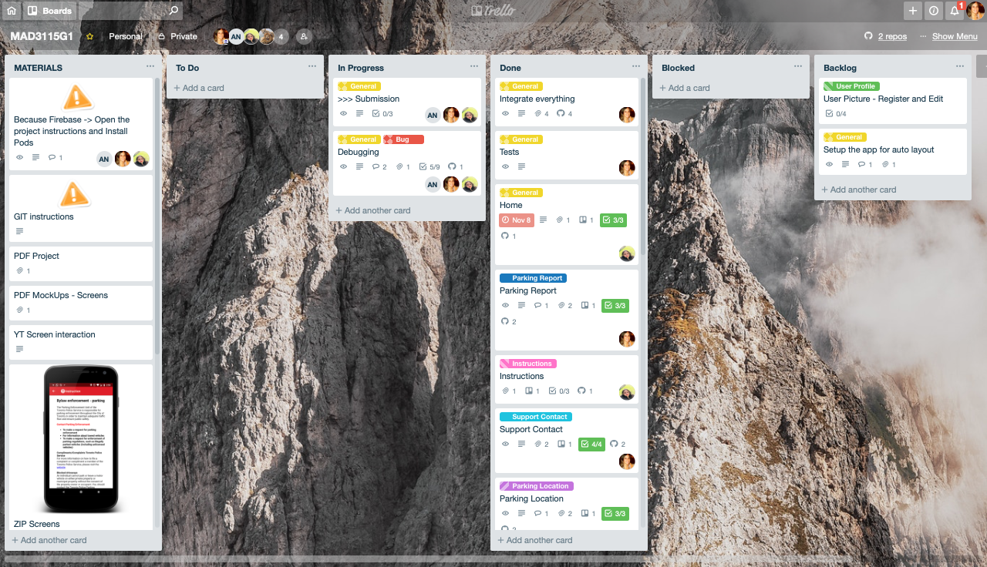
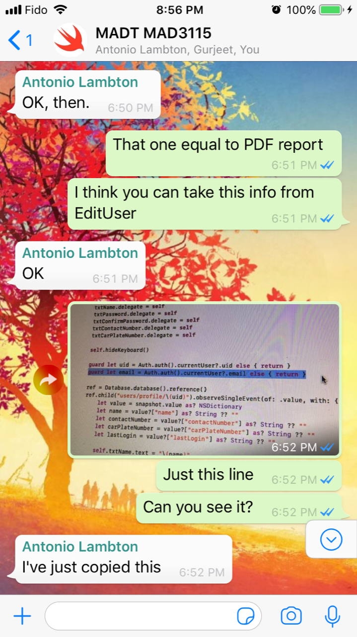
SCRUM
Planning:
- Trello (our Kanban board)
- One sprint only (3 weeks)
”Daily meeting”:
- WhatsApp group
Review:
- Tests and merge with master after each feature concluded
Retrospective:
- Lessons learnt and difficulties discussed

Slide 6
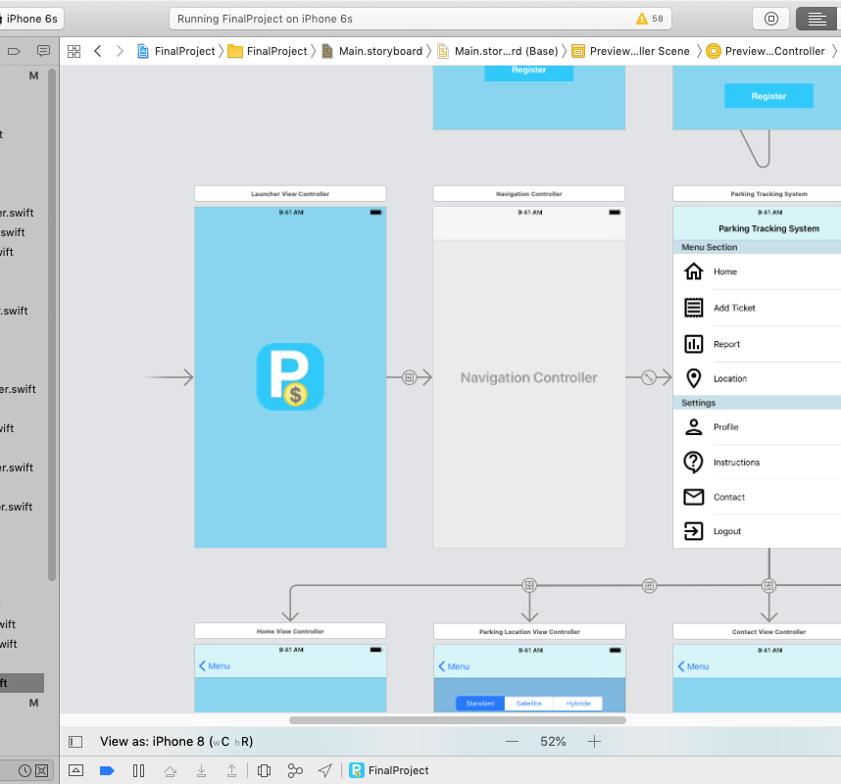
CONTENT
What we are covering?
1. Your project should start with the launcher screen with a logo or application name.
It remains 0.5 seconds before go to Login screen OR Menu.
It will depend if the user was logged since before or not.

Slide 7
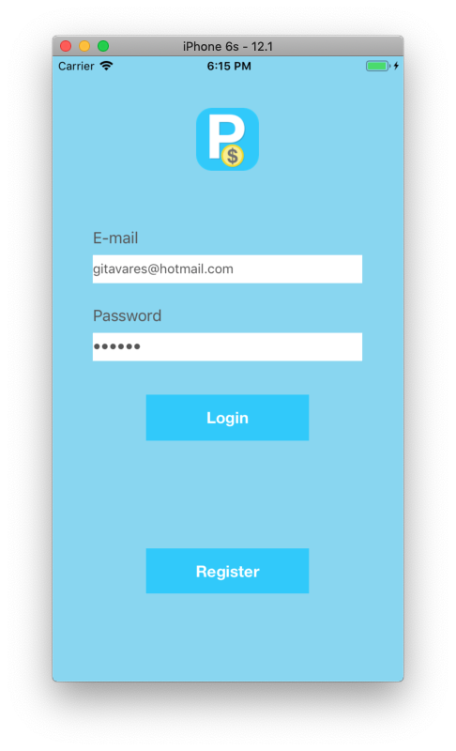
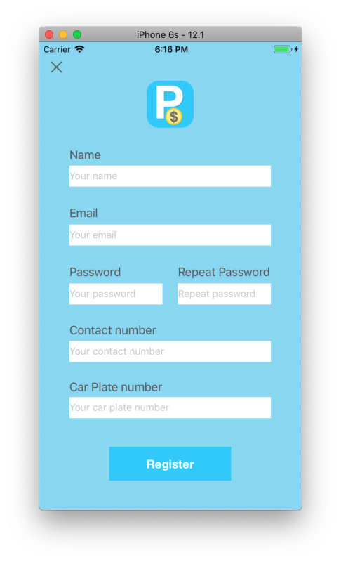
CONTENT
Login and Password registered on Firebase Authentication. It`s calling the Firebase framework
What we are covering?
2. A login screen should appear next which allows user to login using Email and password or register the user in application.
Register screen. The data will be storage on Firebase Authentication and Realtime Database (the extra data)

Slide 8
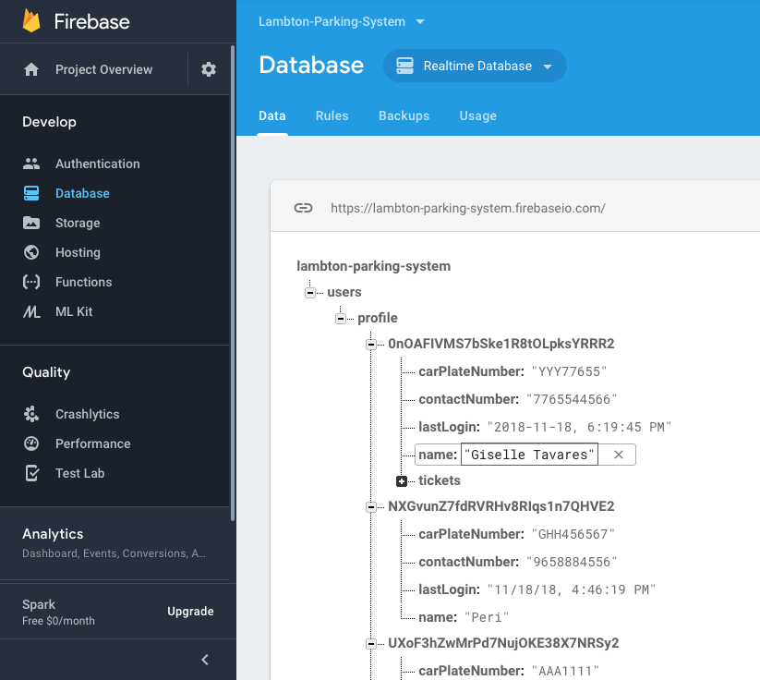
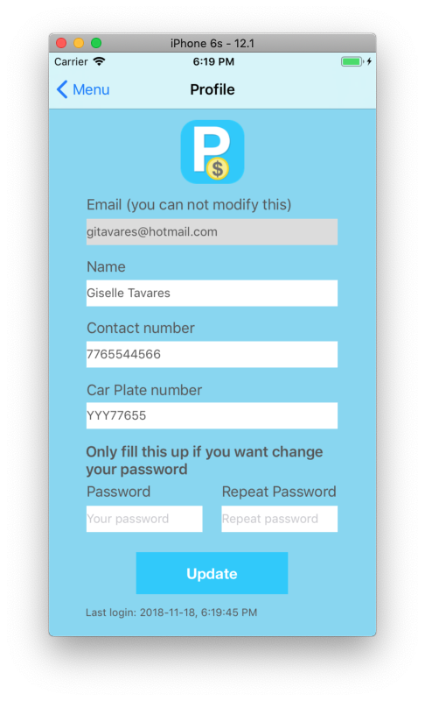
CONTENT
What we are covering?
3. Registration should accept following information from the user and create a new user object.
- Name
- Email
- Password
- Contact Number
- Car Plate Number Also store date and time of last login by the user.
Continuing the Register screen, we can see on Edit Screen and on Firebase that the Last Login is saving.

Slide 9
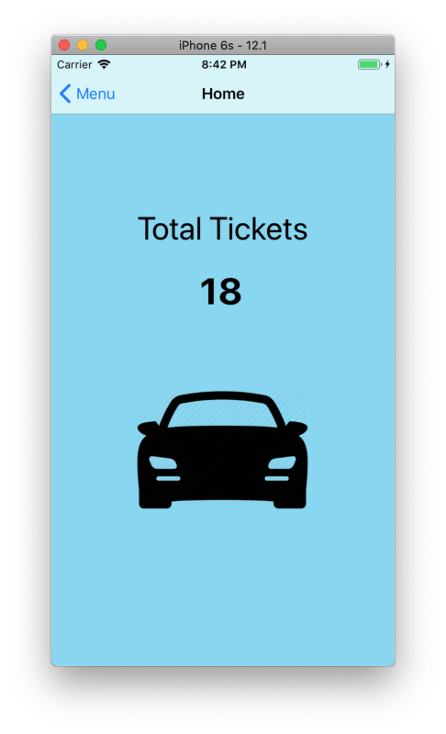
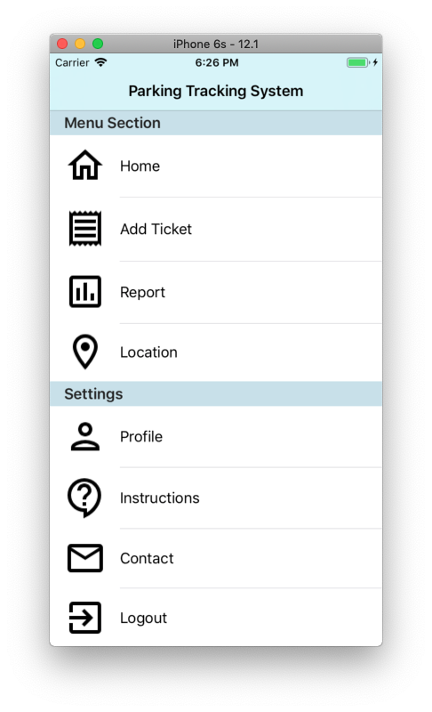
CONTENT
What we are covering?
4. Upon successful login, user should land on the home screen which should display following menu items:
Parking Payment Receipt
Parking Location
Parking Report
User Profile
Parking Manual
Support Contact
Logout
It’s shows the number of children on Firebase from ticket branch for the user logged.
Menu using TableViewController. and embeded by Navigation. For each option we call a function that calls the correspondent segue.

Slide 10
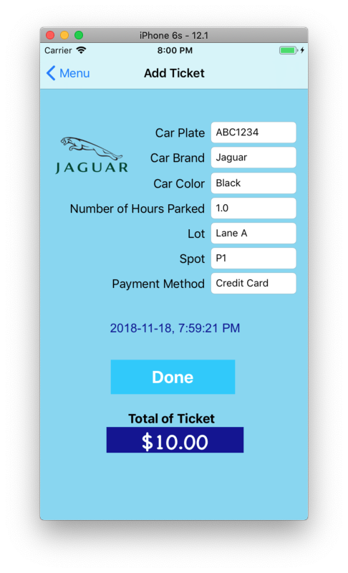
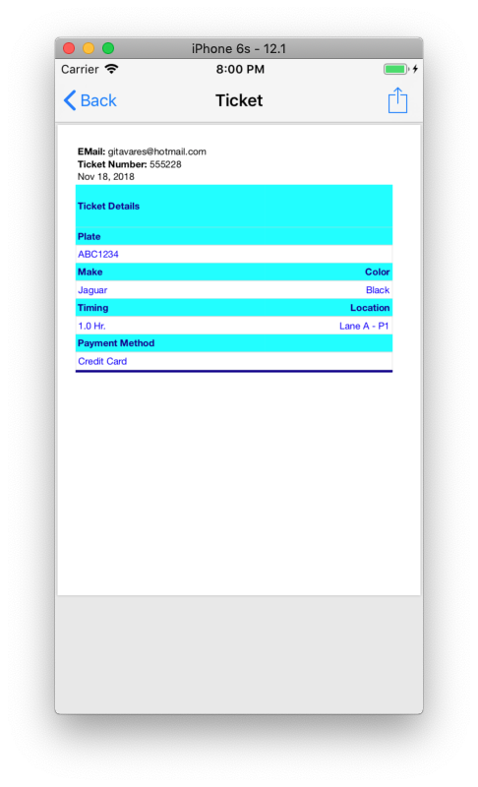
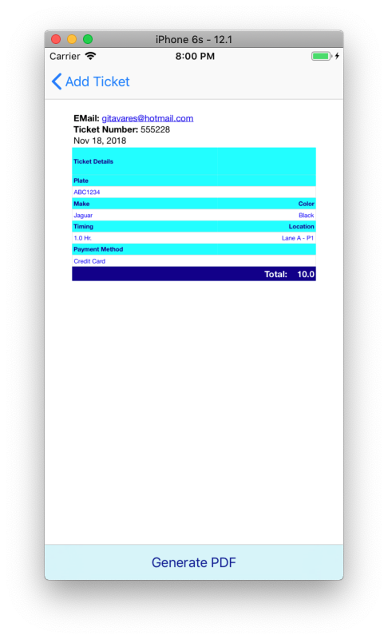
CONTENT
What we are covering?
5. Parking Payment Receipt
Parking payment receipt should accept following information from the user:
> User Email Address, Car plate number, Car Company [upon selection of company appropriate logo should be displayed], Car color, No. of hours parked, Date and Time, Lot number, Spot number, Payment method, Payment amount.
After entering all information, it should be displayed in proper format in next screen. You may also generate pdf contain all information in proper format.
The receipt load a HTML WebKit framework and WKWebView component and generate the PDF with the same information.
This screen is using pickers for almost all fields. Also, there are some auto layout implemented. Some protocols were implemented also: UITextFieldDelegate, UIPickerViewDataSource, UIPickerViewDelegate

Slide 11
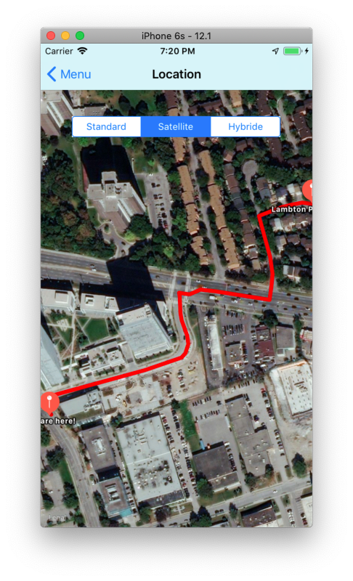
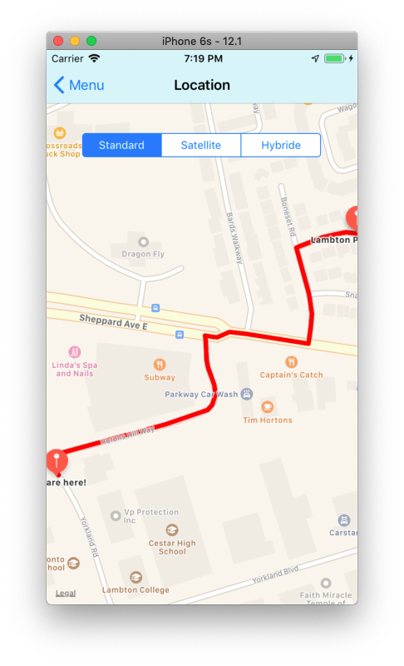
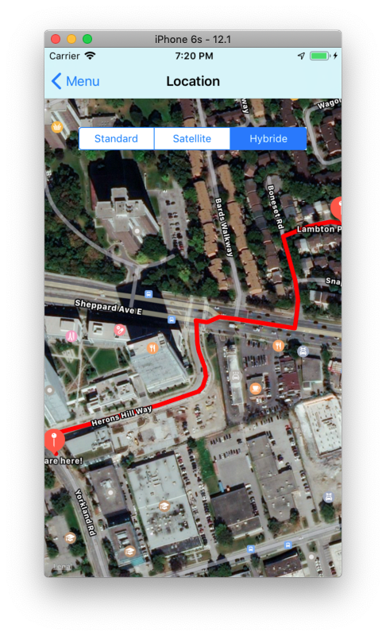
CONTENT
What we are covering?
6. Parking Location
Upon selection of Parking Location menu, you may display location of parking spot on Map with appropriate title.
This screen is using the MapKit framework, also a segment UI element. To pick the current user position, the user must allow the App access the GPS from its dispositive. Also, some protocols were implemented: MKMapViewDelegate, CLLocationManagerDelegate

Slide 12
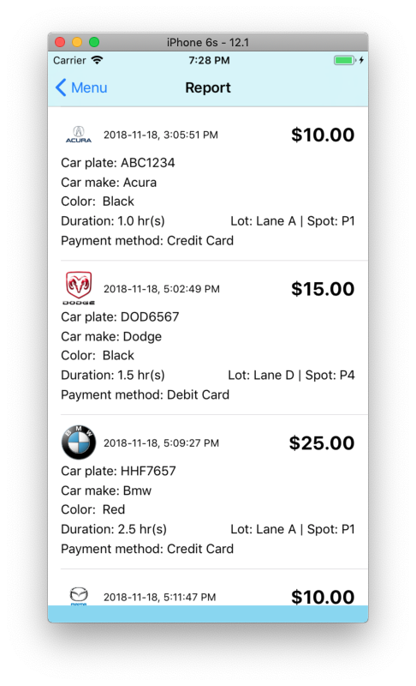
CONTENT
What we are covering?
7. Parking Report
Parking report should display information about all the parking done so far.
This screen is using TableView + TableViewCell customized. Inside each cell, there is a View UI with other UIs elements. The data are collected by Firebase and appended on the Object called Tickets with the same properties. Some protocols were implemented: UITableViewDataSource, UITableViewDelegate

Slide 13
CONTENT
What we are covering?
8. User Profile
User Profile should allow user to store or update user information.
This screen is using UI elements and a specific keyboard for each field. The data are collected from Firebase.

Slide 14
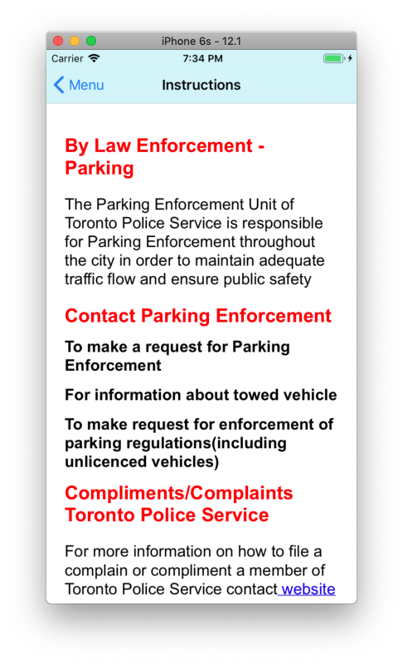
CONTENT
What we are covering?
9. Parking Manual
It should display guidelines for using the application.
The Instructions are loaded on a WebKit framework and WKWebView UI. It was made in a HTML file.

Slide 15
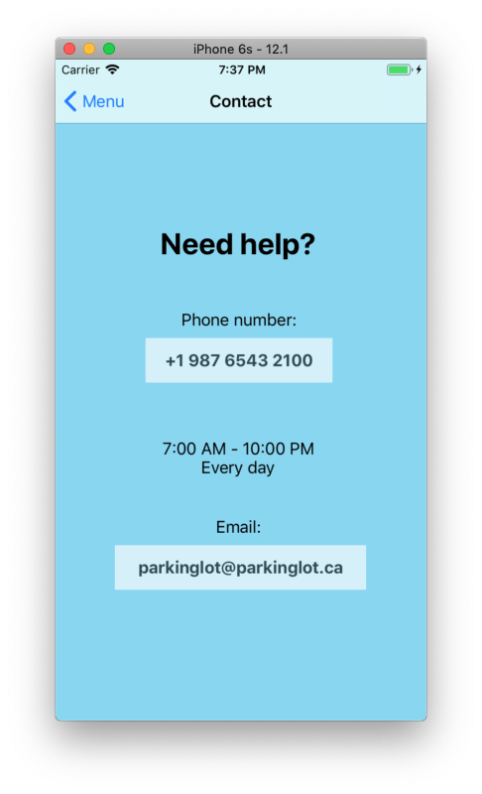
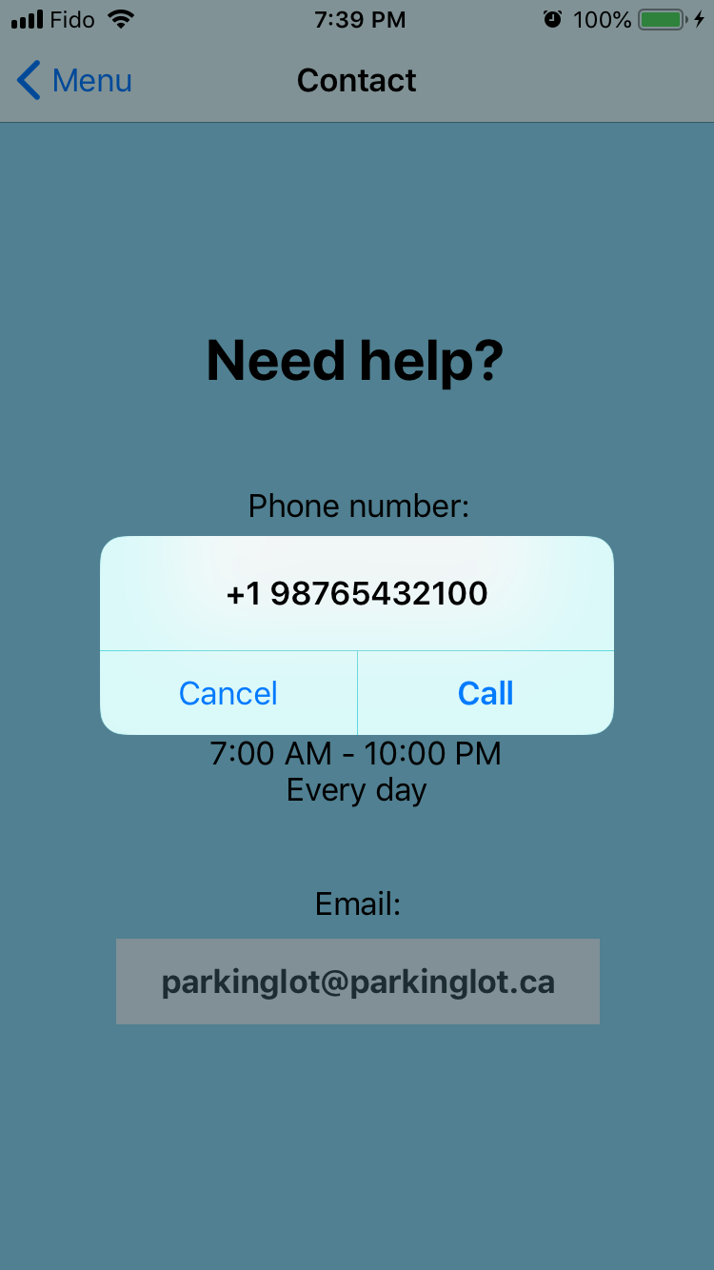
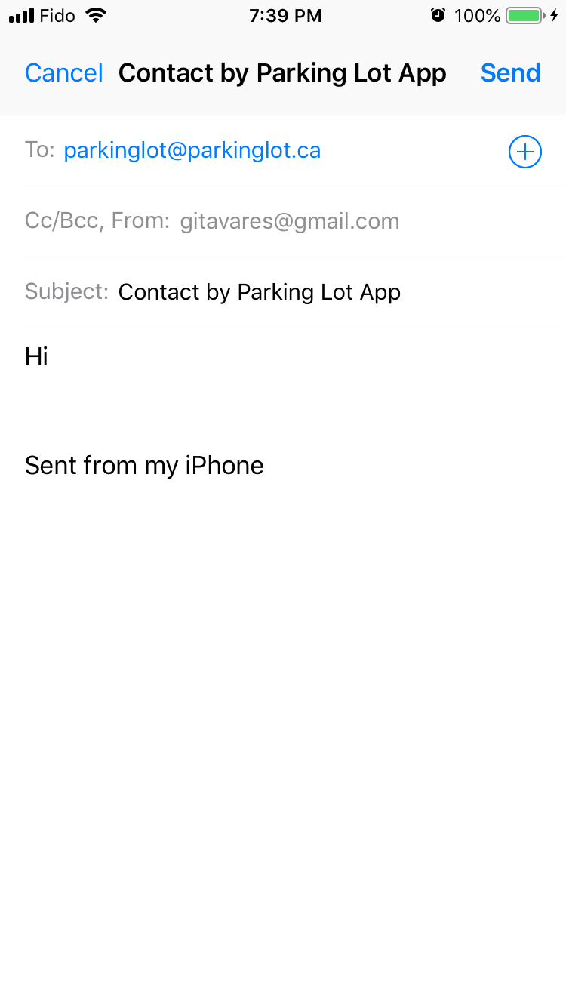
CONTENT
What we are covering?
10. Support Contact
- Support Contact should have the contact details [Email, Phone No.] of the support person.
- Upon selecting Email, it should open an Email application for sending email.
- Upon selection of Phone No., Call dialer should be opened.
The contact is using the MFMailComposeViewControllerDelegate to send Email. For the phone call, it’s using a property from UIApplication to open URL.

Slide 16
CONTENT
What we are covering?
11. Logout
For logout, was needed to call the Signout property from the Firebase Authentication.

Slide 17
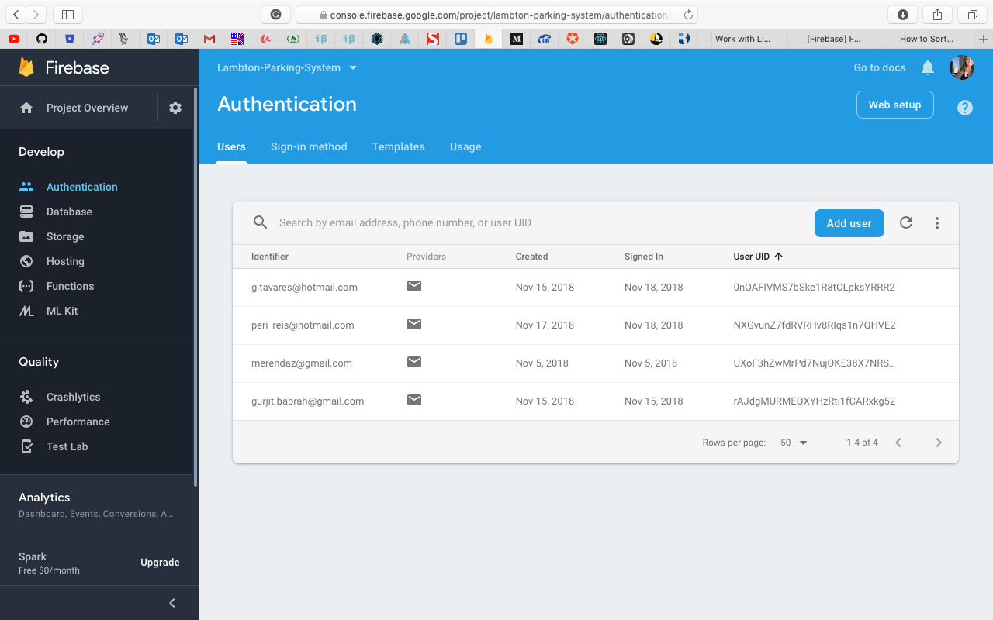
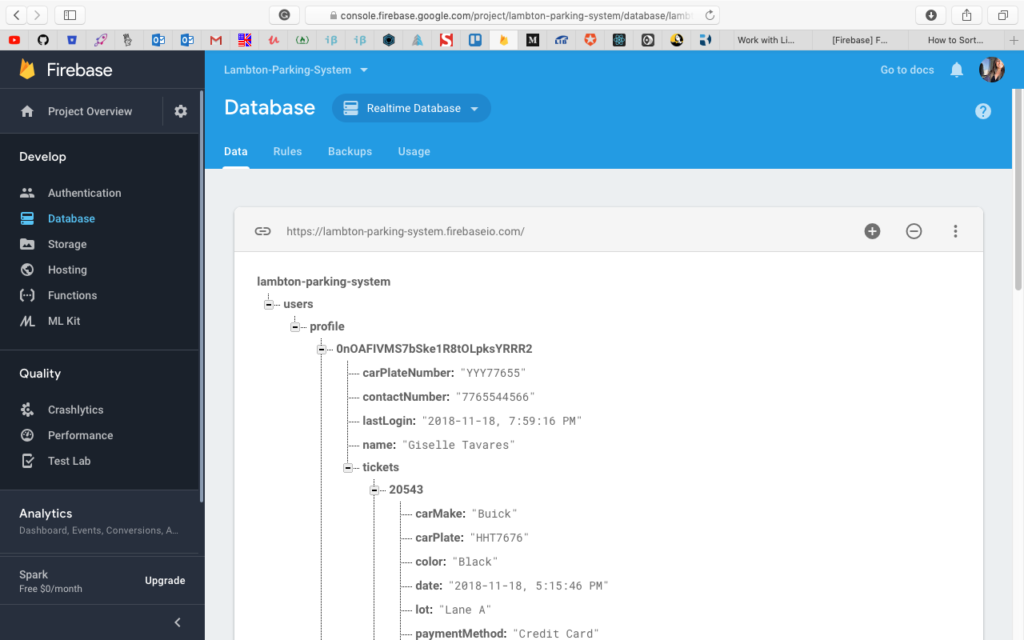
CONTENT
What we are covering?
Authentication
Database (Realtime Database)
To make the Firebase works, it was need to install the framework through Pod Install + set up on the AppDelegate the FirebaseApp.configure()

Slide 18
quick Demonstration

Slide 19
references
Firebase setup: https://firebase.google.com/docs/ios/setup - Accessed in Nov 3rd, 2018
Firebase Auth: https://www.youtube.com/watch?v=UPKCULKi0-A - Accessed in Nov 3rd, 2018
Firebase Database and Storage: https://www.youtube.com/watch?v=gWZP0vDgMtg - Accessed in Nov 3rd, 2018
Firebase UI: https://firebase.google.com/docs/auth/ios/firebaseui - Accessed in Nov 3rd, 2018
Set Google Sign-In: https://stackoverflow.com/questions/39298665/use-of-unresolved-identifier-gglcontext ; https://developers.google.com/identity/sign-in/ios/ - Accessed in Nov 3rd, 2018
Set Auth Firebase: https://github.com/firebase/quickstart-ios/issues/300 - Accessed in Nov 3rd, 2018
RegEx validate email: https://emailregex.com - Accessed in Nov 5th, 2018
Running a function after another: https://stackoverflow.com/questions/35357807/running-one-function-after-another-completes - Accessed in Nov 5th, 2018
Formatting Phone Number: https://stackoverflow.com/questions/32364055/formattting-phone-number-in-swift - Accessed in Nov 5th, 2018
How to get all data from one child on Firebase: https://stackoverflow.com/questions/37903458/how-to-get-all-data-from-one-child-in-firebase-using-swift

Slide 20
references
Formatting Date and Time: http://stackoverflow.max-everyday.com/2018/01/ios-how-to-get-the-current-time-as-datetime-in-swift/ - Accessed in Nov 5th, 2018
Alerts: https://learnappmaking.com/uialertcontroller-alerts-swift-how-to/ - Accessed in Nov 5th, 2018
Editing data from Firebase: https://firebase.google.com/docs/database/ios/read-and-write - Accessed in Nov 12th, 2018
Change password Firebase Auth: https://stackoverflow.com/questions/38410593/how-to-verify-users-current-password-when-changing-password-on-firebase-3 - Accessed in Nov 12th, 2018
Update just some fields on Firebase database: https://stackoverflow.com/questions/46380971/updating-firebase-database-ios-swift-with-multiple-fields-without-overriding - Accessed in Nov 13th, 2018
Map and routes: https://www.ioscreator.com/tutorials/draw-route-mapkit-tutorial - Accessed in Nov 13th, 2018
Hide the keyboard touching any part of screen: https://stackoverflow.com/questions/32281651/how-to-dismiss-keyboard-when-touching-anywhere-outside-uitextfield-in-swift - Accessed in Nov 14th, 2018
Hide keyboard on return key: https://www.youtube.com/watch?v=bhp08NX4Pe4 - Accessed in Nov 14th, 2018
Updating Cell on TableView: https://stackoverflow.com/questions/46545468/swift-firebase-retrieve-data-into-tableview - Accessed in Nov 16th, 2018
How to Generate PDF using HTML Templates and UIPrintPageRenderer in iOS;
https://www.appcoda.com/pdf-generation-ios/
Simple app to turn photos into PDF photo books;
https://github.com/SwiftProgrammingCookbook/PhotobookCreator

